Slide 1
Automated Seed Planter
By
Nandagopal Srinivasan
Prithviraj Prabhu
Sanjana Smruthi S.
Vivek Sivaraman N.
Department of Electronics and Communication Engineering
SSN College of Engineering

Slide 2
PROJECT TITLE : Automated Seed Planter
DURATION : 10 Months
COST : Rs.24400/-
PROJECT MEMBERS : Nandagopal Srinivasan
Prithviraj Prabhu
S. Sanjana Smruthi
Vivek Sivaraman N.
FACULTY MENTORS : Dr. S. Joseph Gladwin
Dr. R. Rajavel
DEPARTMENT : Electronics and Communication Engineering
INSTITUTION : SSN College of Engineering

Slide 3
Introduction
Seed plantation is one of the most important steps of agriculture.
Existing methods are either expensive or labour-intensive.
Automation of the task overcomes most of these hurdles.
The solution is an autonomous, intelligent vehicle capable of sowing a field.

Slide 4
Features
Caterpillar treads.
Tills to create a furrow in the ground.
An arrangement to close the furrow after the seed has been dropped.
All electronics in a water and dust-proof box.
Aluminium and Plexiglas body.
Lithium ion batteries.
Accelerometer and Magnetometer.
Ultrasonic rangefinders and proximity sensors.
Moisture-free seed box.

Slide 5
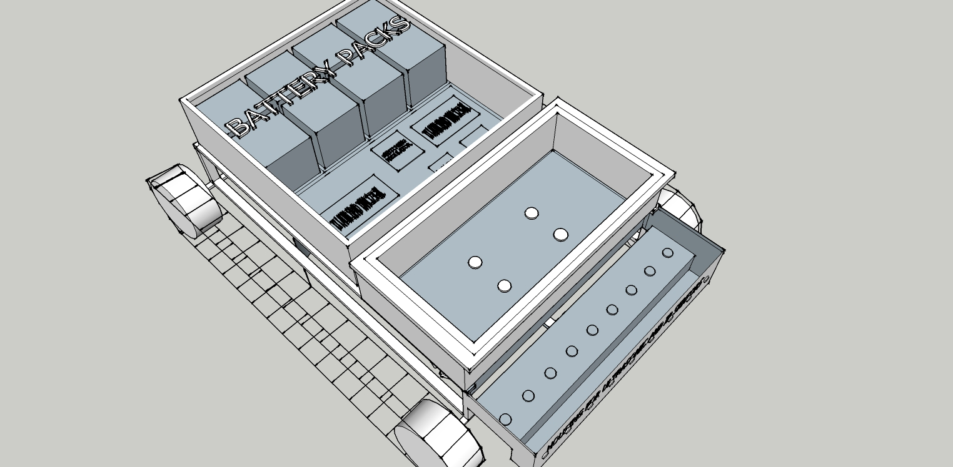

Slide 6
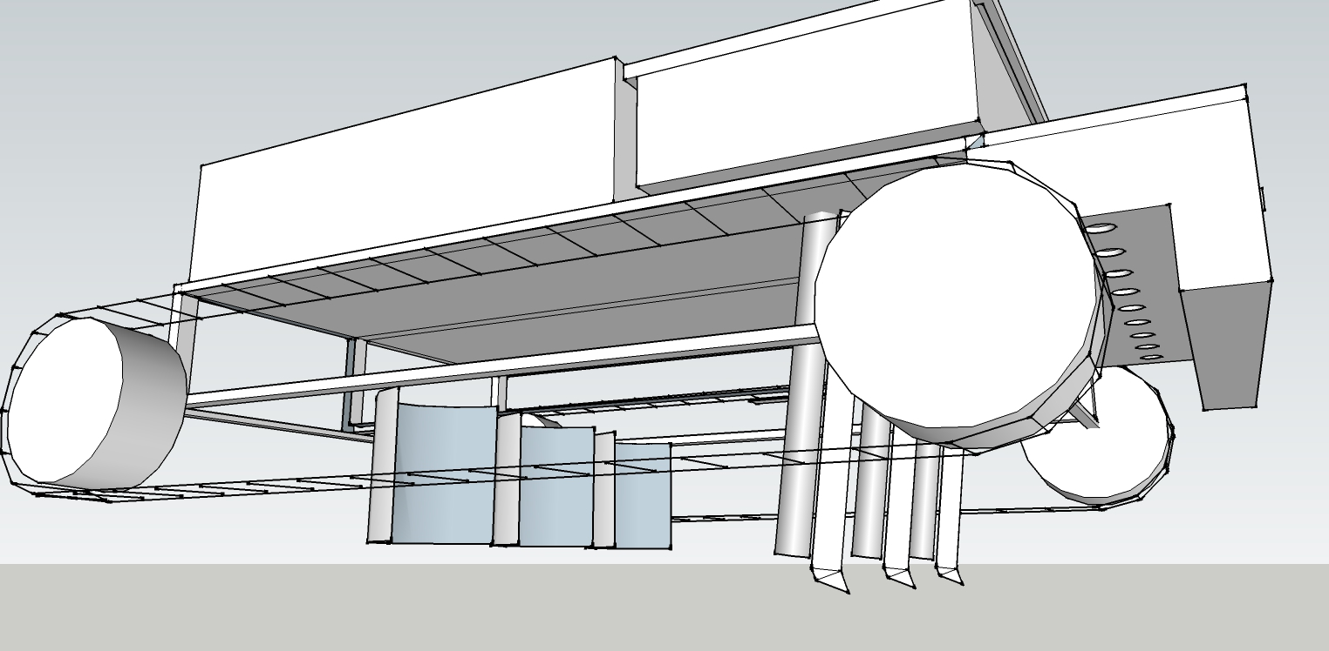

Slide 7
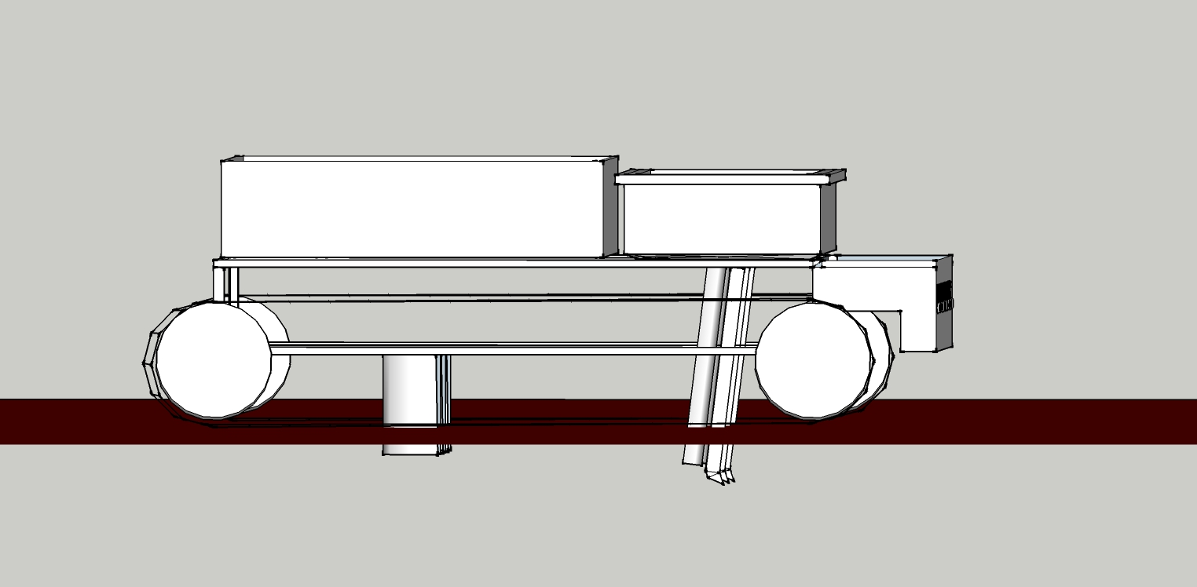

Slide 8
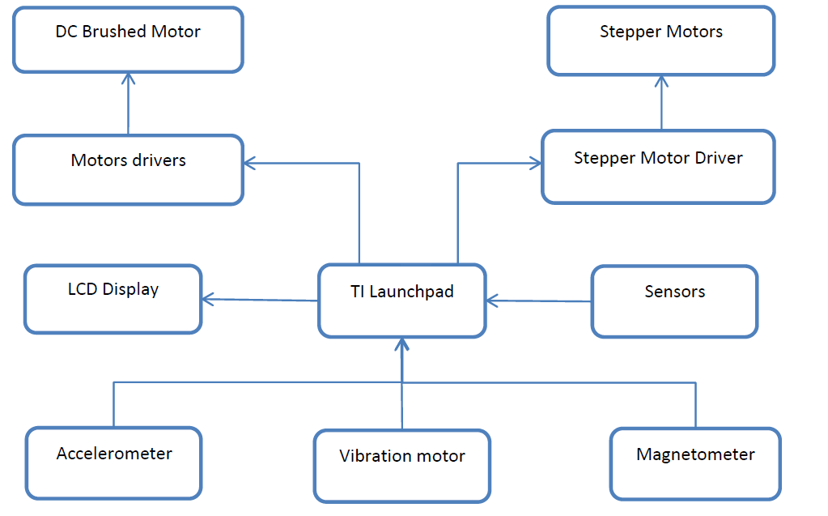

Slide 9
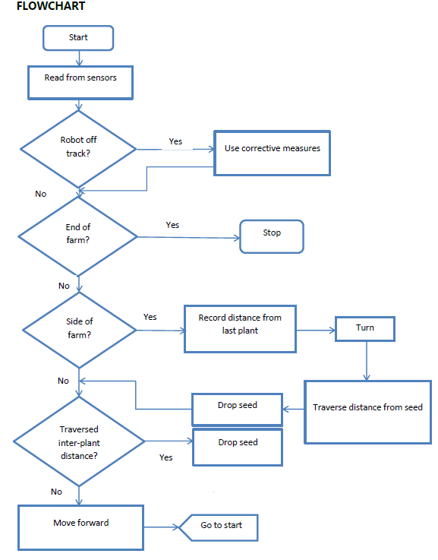

Slide 10


Slide 11
Cost of materials
Item Name | Specification | Quantity | Cost (₹)
Accelerometer | MMA8452Q/ADXL345 | 1 | 600
Magnetometer | HMC5883L | 1 | 600
DC Motors | Johnson Motor – 60rpm | 4 | 2100
Aluminium Extrusion | Flat, L section, Box Section | 3m each | 3000
Stepper Motors | Medium torque | 4 | 1000
TI Launchpad TM4C123GXL | ARM Cortex M4F | 4 | 2400
Switching Regulator | LM2738 | 4 | 300
Lithium-Ion Cell | 4.2V, 2200 mAh | 20 | 3000
Ultrasonic Sensor | HC-SR04 | 8 | 1200
Lithium Battery Charger | BQ2057T | 10 | 600

Slide 12
Cost of materials
Item Name | Specification | Quantity | Cost (₹)
Infrared Proximity Sensors | TSOP1738 Based | 10 | 300
Acrylic Sheet |  | 9 sqft | 500
Power MOSFETs | CSD88539ND (Dual N MOSFET) | 10 | 250
LCD Display | 20x4 | 1 | 500
Vibration Motor |  | 4 | 180
Stepper Motor Driver | TPL7407L | 10 | 120
Passive Components (Resistors, capacitors, crystals) |  | As required | 250
Fabrication of seed planting unit |  | As required | 5000
Documentation |  | As required | 500
Miscellaneous Expenses |  | As required | 2000
 | Total (₹) |  | 24400

Slide 13
Comparison – Market and Prototype
Types of seed drills / planters in the market- Manual and Automatic
Manual seed drill:- requires human operator to guide the drill, while planting.
Automatic seed drills:-usually attached to tractors , drill seeds into the soil.
There is no completely automated seed drill/planter in the market.
Our seed planter is completely automated and autonomous
Hence it saves human energy and fuel for tractor.
The cost for the prototype is roughly Rs. 25,000, while the average cost of automated seed planter is Rs.36000/-

Slide 14
References
http://agridr.in/tnauEAgri/eagri50/FMP211/lec08.html
http://hillagric.ac.in/edu/coa/agengg/lecture/243/Lecture%2013%20Sowing%20equipment.pdf
http://www.ti.com/tool/ek-tm4c123gxl
http://www.ti.com/product/tm4c123gh6pm
http://www.ti.com/lit/ds/symlink/lm2738.pdf
http://www.micropik.com/PDF/HCSR04.pdf
http://www.micropik.com/PDF/tsop17xx.pdf
http://www.analog.com/media/en/technical-documentation/data-sheets/ADXL335.pdf
http://robokits.co.in/sensors/magnetometer/hmc5883l-3axis-compass-magnetometer-module
http://www51.honeywell.com/aero/common/documents/myaerospacecatalog-documents/Defense_Brochures-documents/HMC5883L_3-Axis_Digital_Compass_IC.pdf

